Slide 1
Introduction to Data Mining
2024.02.29.
Taek-Ho Lee

Slide 2
About data mining
Topics covered in this class
About this class (including assessment criteria)

Slide 3
What is data mining?
Definition of “data mining”
Data mining (the analysis step of the "Knowledge Discovery in Databases" process, or KDD), an interdisciplinary subfield of computer science, is the computational process of discovering patterns in large data sets ("big data") involving methods at the intersection of artificial intelligence, machine learning, statistics, and database systems.
The overall goal of the data mining process is to extract information from a data set and transform it into an understandable structure for further use.
Aside from the raw analysis step, it involves database and data management aspects, data pre-processing, model and inference considerations, interestingness metrics, complexity considerations, post-processing of discovered structures, visualization, and online updating.

Slide 4
What is data mining?
Definition of “data mining”
Data mining (the analysis step of the "Knowledge Discovery in Databases" process, or KDD), an interdisciplinary subfield of computer science, is the computational process of discovering patterns in large data sets ("big data") involving methods at the intersection of artificial intelligence, machine learning, statistics, and database systems.
The overall goal of the data mining process is to extract information from a data set and transform it into an understandable structure for further use.
Aside from the raw analysis step, it involves database and data management aspects, data pre-processing, model and inference considerations, interestingness metrics, complexity considerations, post-processing of discovered structures, visualization, and online updating.
Data mining is
discovering patterns or extracting information from data to utilize results for further use.
(Action)
(Resource)
(Purpose)
Notes:
To summarize, data Mining is discovering patterns or extracting information.
However, this is done by using data that can be read by a computer.
In other words, we transform the data into valuable insights for decision-making or problem-solving.
From this class, we will learn various data mining techniques and how to apply them using python.

Slide 5
What is data mining?
Data mining vs. Machine learning vs. Artificial intelligence
Extracting rules or patterns
Predictive analytics
Artificial
Intelligence
Data Mining
Data management
Descriptive analytics
Visualization
Machine Learning
Natural language processing
Vision
Speech recognition

Slide 6
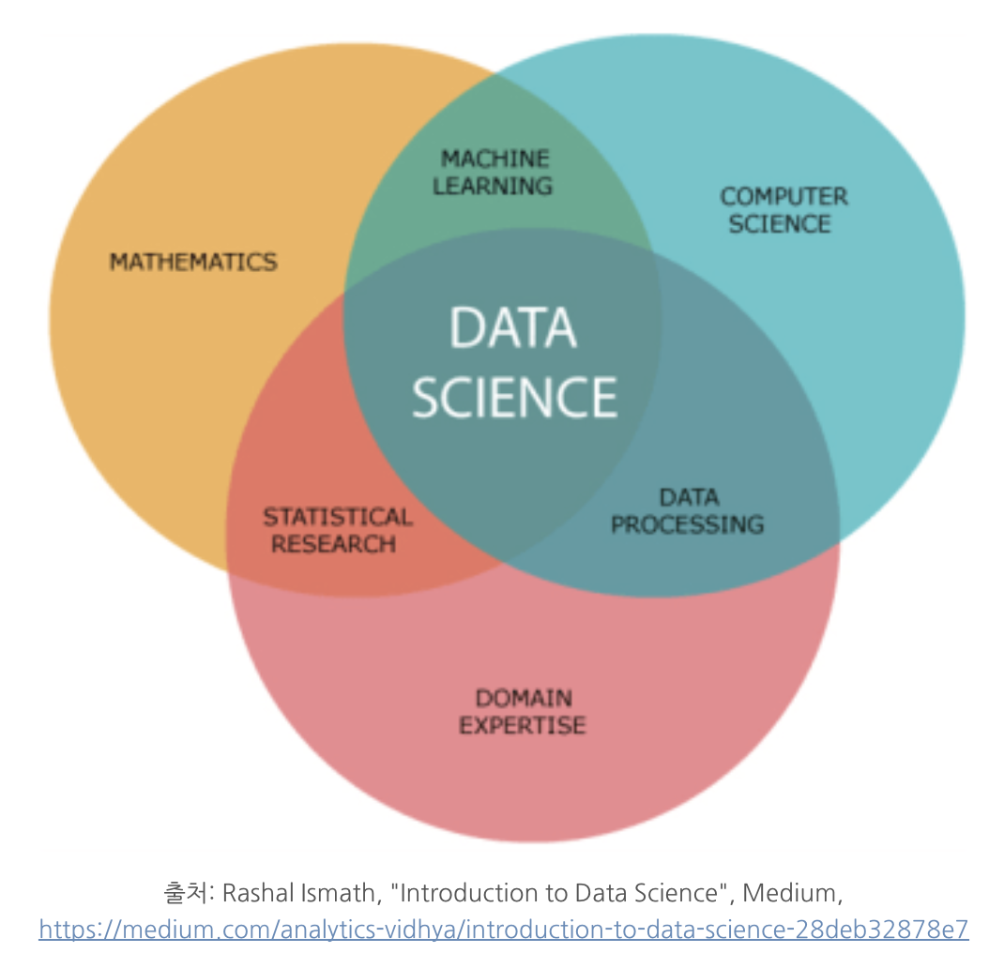
Data mining as a part of data science
Data science if multidisciplinary

Slide 7




Application areas of data mining
You may also like/know/buy: Recommendation

Slide 8
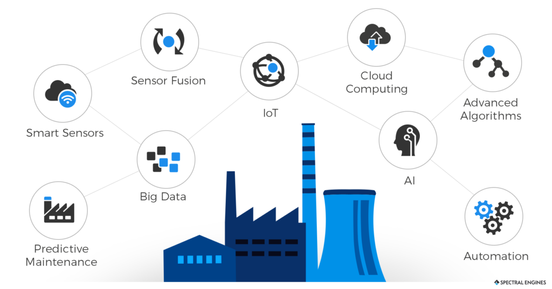
Application areas of data mining
Industry 4.0
Connected devices are collection data
Smart factory, autonomous systems

Slide 9
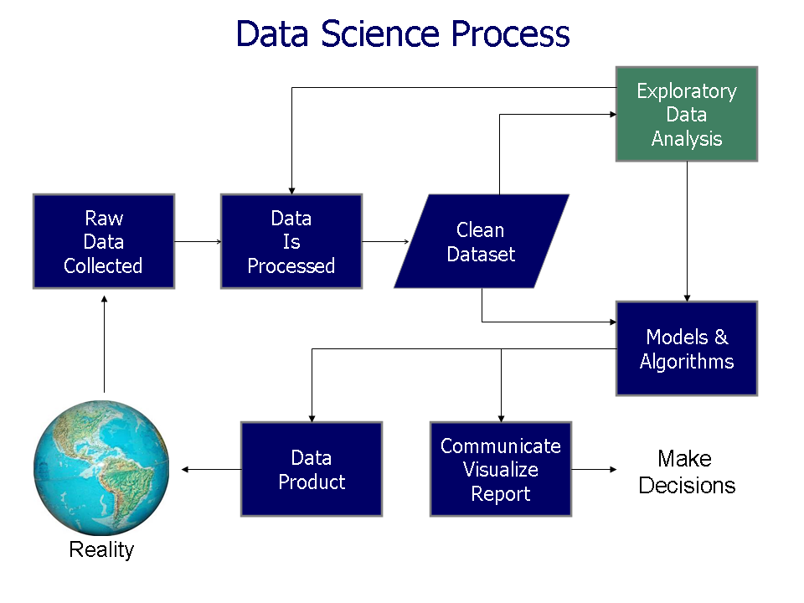
What we will learn in this class

Slide 10
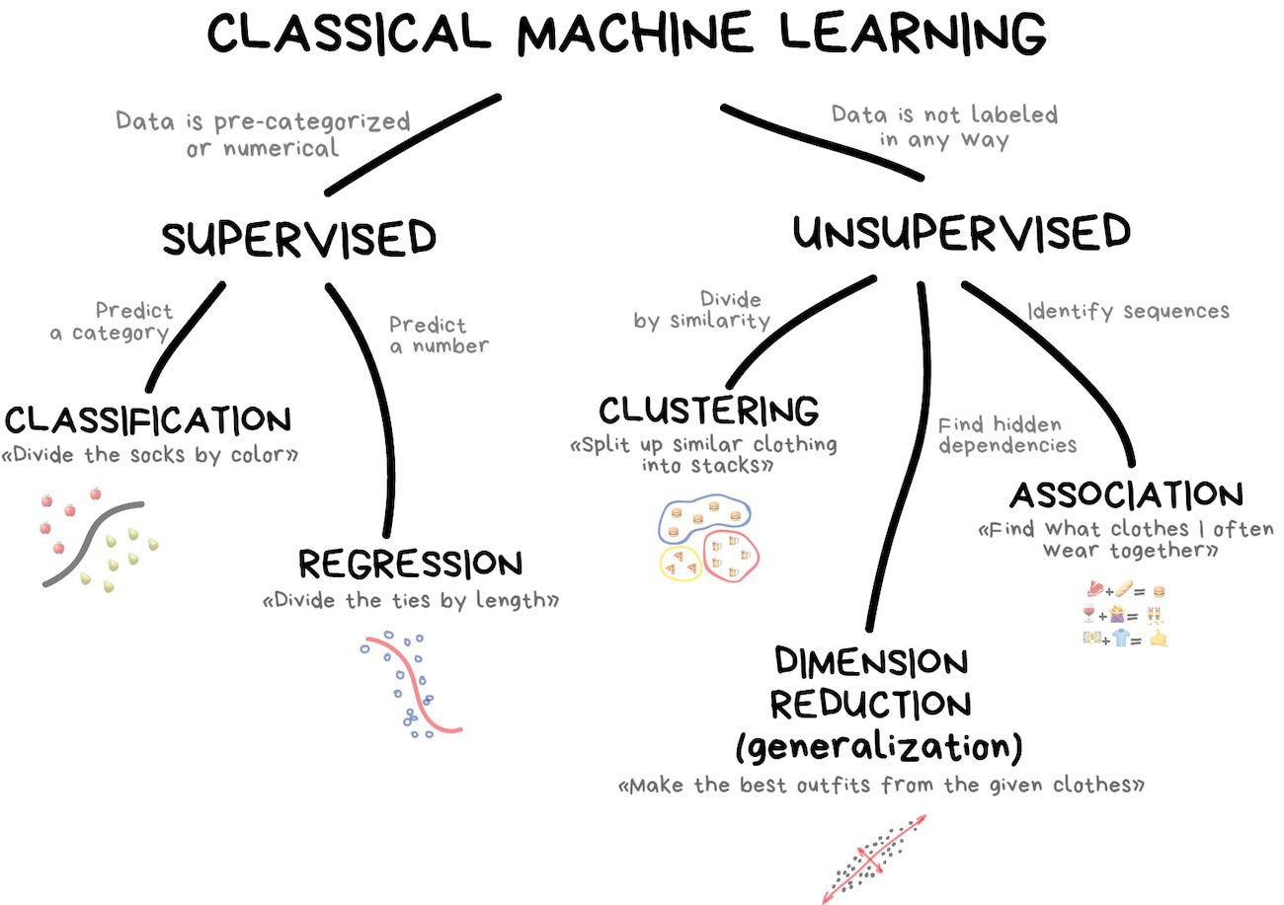
Topics covered in this class

Slide 11

Topics covered in this class
Supervised learning
Regression
Linear regression
Nearest neighbor methods
Decision tree
Classification
Logistic regression
Naïve Bayes
Nearest neighbor methods
Decision tree
Unsupervised learning
Clustering
$k$-means
Hierarchical clustering
Dimension reduction
Principal component analysis (PCA)
Association rule mining

Slide 12
Principals of lecture
Understand main goal and basic principles of each data mining techniques
Why is an algorithm proposed?
What is a key point?
→ Deliver principles as easy as possible without mathematics
Understand detailed process of each data mining techniques
How are an algorithm working?
→ Explain process step by step
Some equations will be introduced for explanation
Exercise what you learned during lectures
Main programming language: Python
Confirm algorithms studied during lectures through programming exercises

Slide 13
Principals of lecture: Assessment
Course assessment
Exams will be held two time: mid-term and final exams
Final exam will cover the whole lectures
Programming assignments related with lectures
Team presentation: Case study
Topic proposal will be presented on the 9th week
The final result will be presented on the 15th week
Each team consist of 2~3 students (random)

Slide 14
Principal of lecture: assessment
Exams
Assess the theoretical knowledge learned in this class
Must understand principles and process of the data mining algorithms covered in this class
No multiple choice questions
Can use a scientific calculator
Schedule
Mid-term exam: 8th week, 4/18 (in the evening)
Final exam: 14th week, 5/30 (in the evening)

Slide 15
Principal of lecture: assessment
Team presentation
Case study using data mining
The purpose of data analysis
What is the problem?
Method
How did they solve the problem through data mining?
Result
What kinds of implication could be derived from the results of data analysis?

Slide 16
Schedule
Week | Date | Contents | Notes
1 | 2/29 | Introduction | On the last week of this class, Thursday is a holiday, so we may need to adjust the schedule.
2 | 3/7 | Background of data mining
3 | 3/14 | Linear regression: Theory Part 1 & Exercise
4 | 3/21 | Linear regression: Theory Part 2 & Exercise
5 | 3/28 | Linear regression: Theory Part 3 & Exercise
6 | 4/4 | Logistic regression: Theory & Exercise
7 | 4/11 | Naïve Bayes classifier: Theory & Exercise
8 | 4/18 | Mid-term exam
9 | 4/25 | Nearest neighbor algorithm: Theory & Exercise Presentation: Case study topic proposal
10 | 5/2 | Decision tree: Theory & Exercise
11 | 5/9 | Clustering: Theory & Exercise
12 | 5/16 | Dimensionality reduction: Theory & Exercise
13 | 5/23 | Association rule mining: Theory & Exercise
14 | 5/30 | Final exam (in the evening)
15 | 6/6 | Presentation: Case study

Slide 17
Q&A
If you want to ask a question related with lectures for data mining algorithms outside of class, please use the Q&A board of the e-class.
Your question may be helpful to other students.
Share your questions with other students
Do not ask individual questions not related to the lecture by e-mail.

